Slide 1

Tri-Lingual Sign Language Translator

Slide 2
Agenda
01
02
03
04
05
06
Team Introduction
Problem Statement
Deep Learning Architectures - Comparative Study
Mult-Lingual Sign Language Translator
Results & Discussion
Conclusion

Slide 3

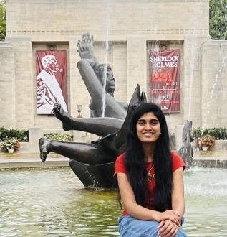

Team Members
Shivangi Sharma
Sravya Vujjini
Drumil Joshi

Slide 4
Problem Statement
· To study various machine learning and deep learning architectures, and to create the best performing model based on defined metrics.
· To build a multiple sign language translator, which can take communications in one sign language and translate them into written text as well as other sign language hand gesture representations to enable trilingual communication.
The proposed system uses three of the most recognised sign languages named American Sign Language (ASL), German Sign Language (GSL) and Indian Sign Language (ISL) image datasets that will be pre-processed based on threshold and intensity.
The system will recognize the alphabets of different sign languages and the proposed system uses the hand gestures in the sign language recognition system.

Slide 5
Comparative Study Of Deep Learning Architectures
For Our Project we have implemented 5 Architectures which are as follows:
Classic Sequential Neural Network Model
Convolutional Neural Network Model
VGG 16 Model
DenseNet Model
AlexNet Model

Slide 6
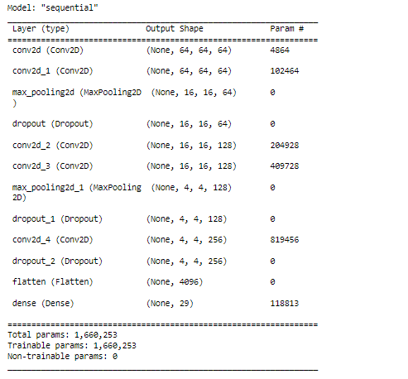
Classic Sequential Neural Network Model

Slide 7
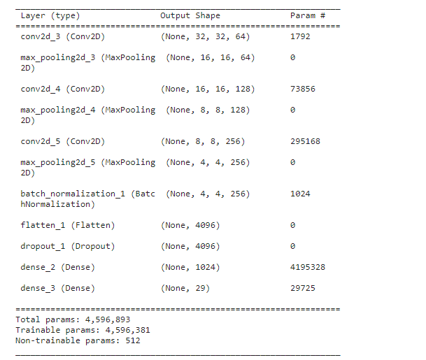
Convolutional Neural Network Model

Slide 8
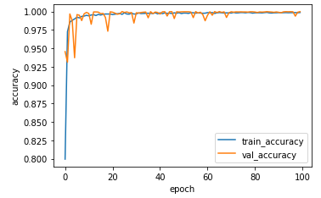
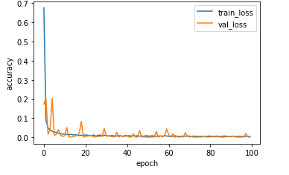
Classic Sequential Neural Network Model

Slide 9
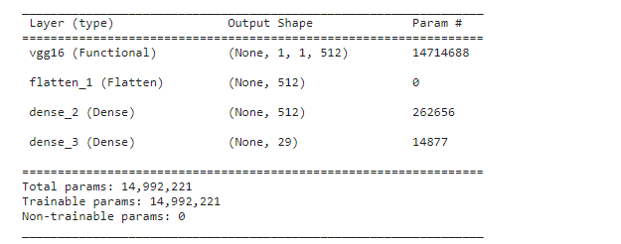
VGG 16 Model

Slide 10
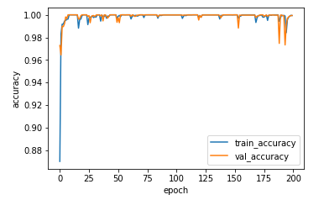
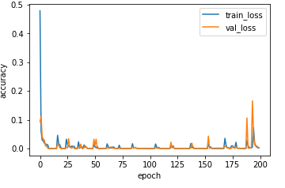
VGG 16 Model

Slide 11
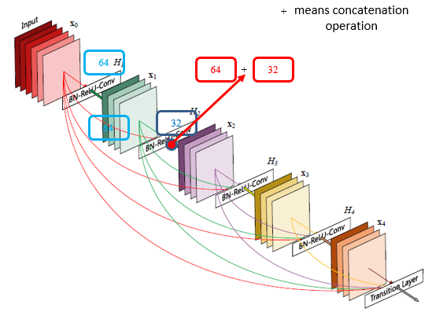
DenseNet Model

Slide 12
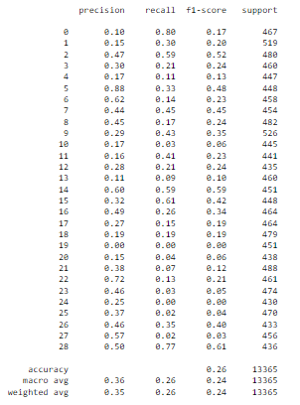
DenseNet Model

Slide 13
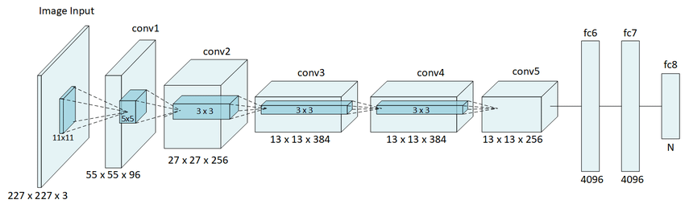
AlexNet Model

Slide 14
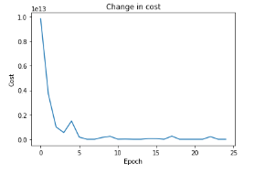
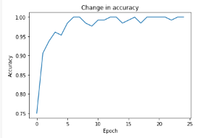
AlexNet Model

Slide 15
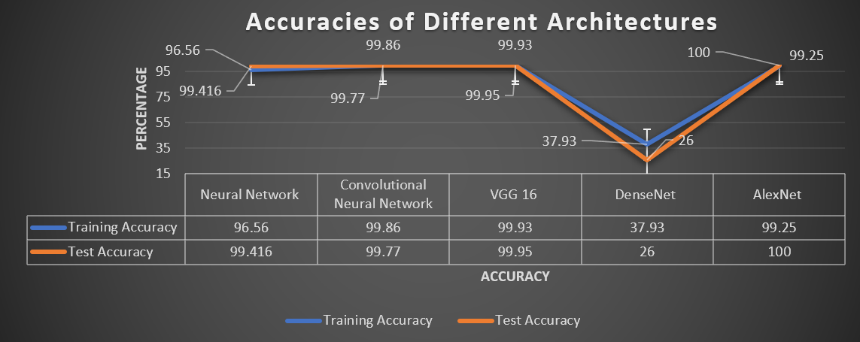
Results & Discussion
Accuracy Pattern for experiments

Slide 16
Multi - Lingual Sign Language Translator

Slide 17
Multi - Lingual Sign Language Translator
The Best performing Model for predictions was Convolutional Neural Network Model.
Some Minor Modifications were done in the architecture.

Slide 18
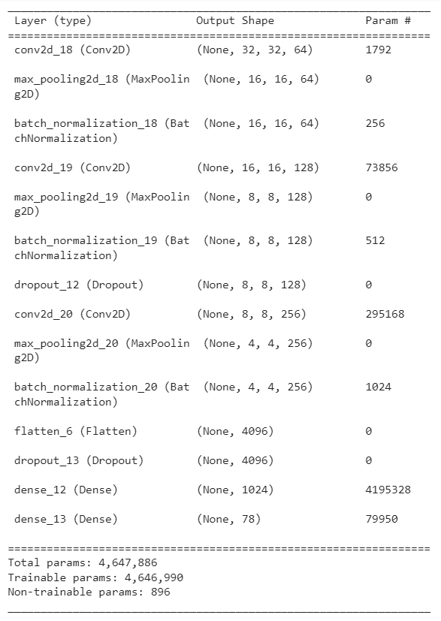
Translator - Convolutional Neural Network

Slide 19
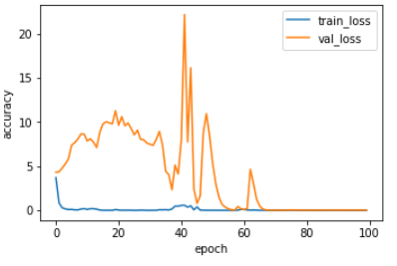
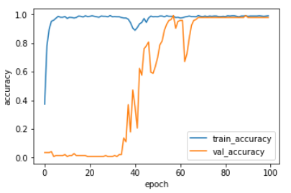
Translator - Epoch Visualization

Slide 20
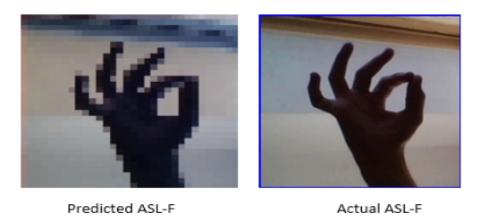
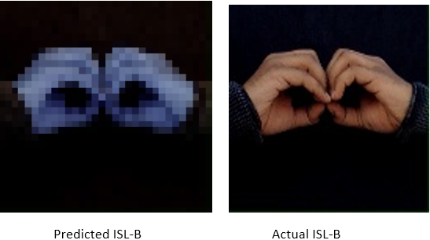
Translator - Real-Predictions

Slide 21
Conclusion
In conclusion, we were successful in creating a system that can comprehend sign language and convert it to matching text.
There are still a lot of gaps in our system, such as the fact that it can only recognize hand motions for the letters A to Z, leaving out body gestures and other dynamic gestures.

Slide 22
Thank You!
Please Feel free to contact for queries :
Shivangi Sharma (sharshiv@iu.edu) - Shivangi Sharma | LinkedIn
Sravya Vujjini (svujjin@iu.edu) - Sravya Vujjini | LinkedIn
Drumil Joshi (dtjoshi@iu.edu) - Drumil Joshi | LinkedIn
The Code for the project can be found at : dtjoshi/Deep_Learning_Project_Mulit-Lingual_Sign_Language_Translator: This is our Project termed as "Multi-Lingual Sign Language Translator"/ (iu.edu)

